Slide 1

Computer Science and Engineering
Title : How Antivirus software is written?
V SEMESTER
​
​
Teammates:
S.Lokesh
T.Nanditha
G.Meghana
K.LOHITH
19951A0581
CSE-B

Slide 2
How antivirus software is written?

Slide 3
How Antivirus software is written?
Problem Type: | Complex
Real-world context: | In the real world antivirus software is used to protect from the threats and the files getting corrupted and so the antivirus is important for anyone to get their files safe.
Real-world processes: | Every user uses different forms of antivirus software for prevention of data getting corrupted in the day to day life and on turning on the pc or any smartphone the main thing used in the first part is checking for any viruses.So,there is a need of antivirus software.
Tools:
Real impact: | Safety of files and privacy to their information.

Slide 4
Introduction
Computer security is the protection of information systems from theft or damage to
the hardware, and the software. It is also known as cyber security or IT security. It
includes controlling physical access to the hardware. It is used as well as protecting against harm that may come via network access, data and code injection.
The last decade has seen a phenomenal growth of internet and communication technology. However it has also offered a platform for rapid evolution of different malicious code including viruses. To challenge new defense mechanism, modern computer viruses use various mutation techniques such as encryption,polymorphism or metamorphism to evade detection
With the evolution of virus from simple encrypted code to much complex mutated code on every replication,the antivirus must become very sophisticated to defend against virus attack. Several methods of detecting the viruses have been deployed. But given the diverse structure and behavior of viruses, a single method is not sufficient to defend against complex attacks. Modern computer antivirus uses different defense mechanisms together to detect known as well as unknown viruses.

Slide 5
Abstract
Defending against virus attacks in network is a vital part of network security. With the rapid evolution of viruses, its defense mechanism has also been evolved Over the years. But given the diversity and complexity of virus propagation and its attack behavior, no defense mechanism is equipped fully to protect the network from such attacks. Several antiviruses are available in the market. But none can give full proof solution to malicious attacks in communication networks. People use computers for all kind of activities:
online gaming, shopping, entertainment, emails, facebook, study, research, etc. At the same time, the risk of infection by malicious programs in these computers is rising.Antivirus software was originally designed as a means to detect and remove viruses from computers. As time passed, the internet evolved and a wide array of technologies were invented. However, this boom did come with a downside: the creation of other, more advanced types of malicious software or malware.

Slide 6
Existing system
The 2000s was a time of even more advancements for the antivirus industry. In 2005, Finland-based company F-Secure developed an anti-rootkit tool called Black Light. They were the first cybersecurity firm to do so.
In 2008, McAfee unveiled Artemis, a cloud-based anti-malware function that was added to the year’s edition of McAfee VirusScan. AVG followed suit in 2011 by creating a similar system they named Protective Cloud Technology.
Over the years it has become necessary for antivirus software to use several different strategies (e.g. specific email and network protection or low level modules) and detection algorithms, as well as to check an increasing variety of files, rather than just executables, for several reasons:
Powerful macros used in word processor applications, such as Microsoft Word, presented a risk. Virus writers could use the macros to write viruses embedded within documents. This meant that computers could now also be at risk from infection by opening documents with hidden attached macros.
The possibility of embedding executable objects inside otherwise non-executable file formats can make opening those files a risk.
Later email programs, in particular Microsoft's Outlook Express and Outlook, were vulnerable to viruses embedded in the email body itself. A user's computer could be infected by just opening or previewing a message.

Slide 7
Proposed System
Following the 2013 release of the APT 1 report from Mandiant, the industry has seen a shift towards signature-less approaches to the problem capable of detecting and mitigating zero-day attacks. Numerous approaches to address these new forms of threats have appeared, including behavioral detection, artificial intelligence, machine learning, and cloud-based file detonation. According to Gartner, it is expected the rise of new entrants, such Carbon Black, Cylance and Crowd strike will force EPP incumbents into a new phase of innovation and acquisition.One method from Bromium involves micro-virtualization to protect desktops from malicious code execution initiated by the end user. Another approach from SentinelOne and Carbon Black focuses on behavioral detection by building a full context around every process execution path in real time,while Cylance leverages an artificial intelligence model based on machine learning.Increasingly, these signature-less approaches have been defined by the media and analyst firms as "next-generation" antivirus and are seeing rapid market adoption as certified antivirus replacement technologies by firms such as Coalfire and Direct Defense. In response, traditional antivirus vendors such as Trend Micro,Symantec and Sophos have responded by incorporating "next-gen" offerings into their portfolios as analyst firms such as Forrester and Gartner have called traditional signature-based antivirus "ineffective" and "outdated".

Slide 8
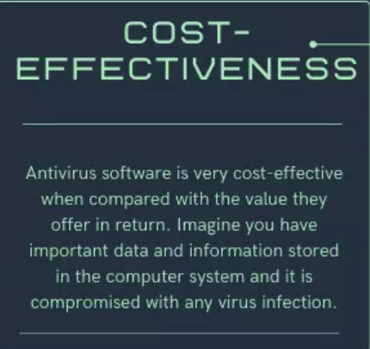
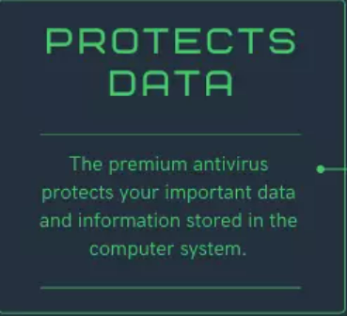
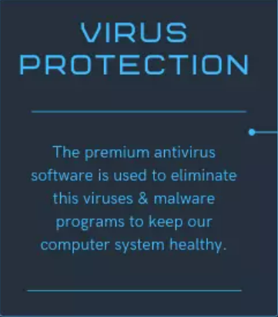
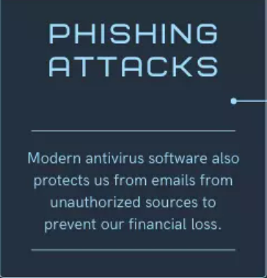
Advantages

Slide 9
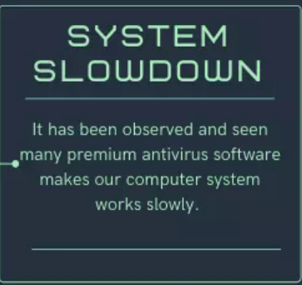
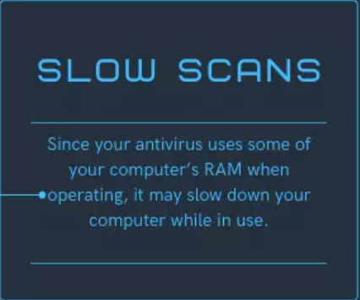
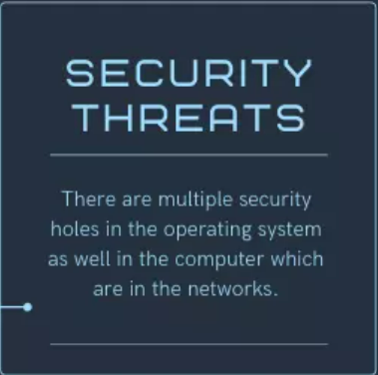
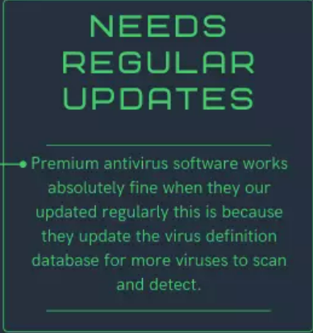
Disadvantages

Slide 10
Conclusion
Most antivirus software options include similar basic features such as scheduled scan, email security, antispyware tools and USB drive scans. With the growing menace of computer virus, the antivirus industry is also gearing up to provide sustainable defense from virus attack. There exist several established methods for detecting known and unknown viruses. But given the diversity and complexity of new viruses, a single defense mechanism may not be sufficient to protect the computer and network from such complex attacks. Modern antivirus uses combination of two or more efficient defense mechanisms to defend against much sophisticated attacks in communication network.

Slide 11


